Slide 1
Bilateral Filtering for Gray and Color Images
Mateusz Sobczyk 226373 Bartosz Gardziński 226518
:

Slide 2
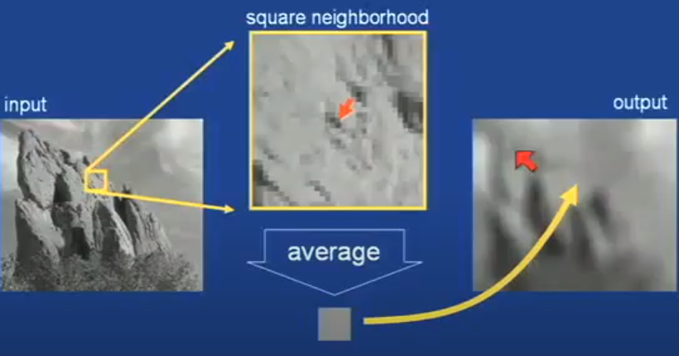
Box Average

Slide 3
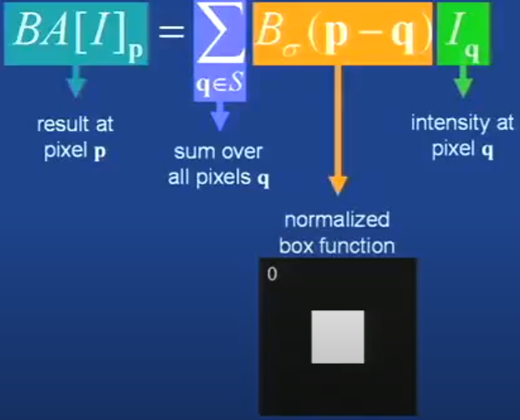
Equation of Box Average

Slide 4
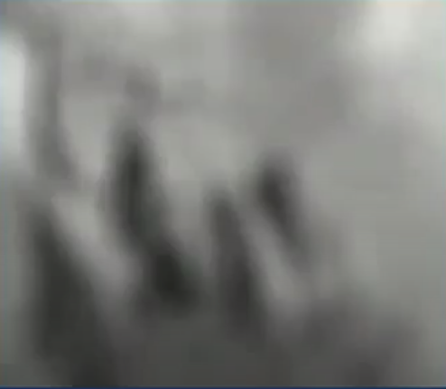
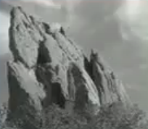
Square Box Defects
output
input

Slide 5
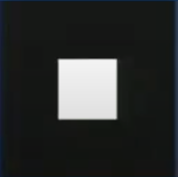
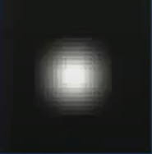
Strategy to solve there Problems
Use an osotropic (circular) window
Use a window with a smooth fallof
Box window
Guassian window

Slide 6
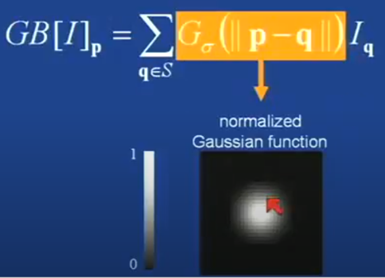
Idea: weighted average of pixels
Equation of Gaussian blur

Slide 7
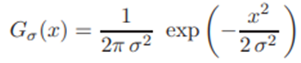
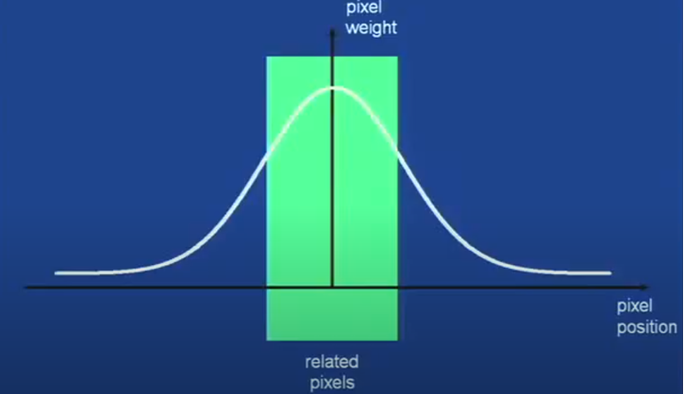
Gaussian profile

Slide 8
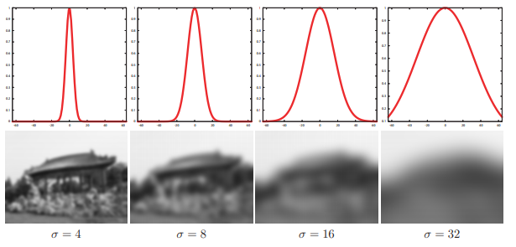
Spatial parameter

Slide 9
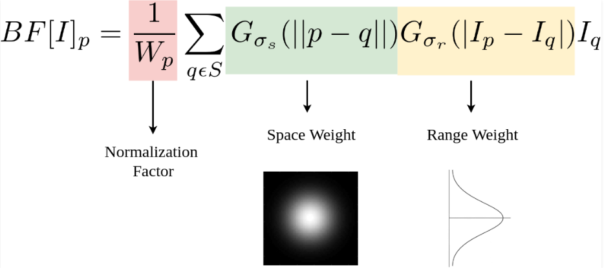
Additional range term

Slide 10
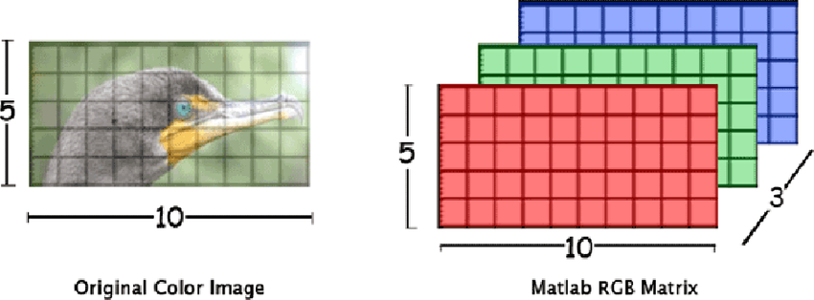
Bilateral filter for color images

Slide 11
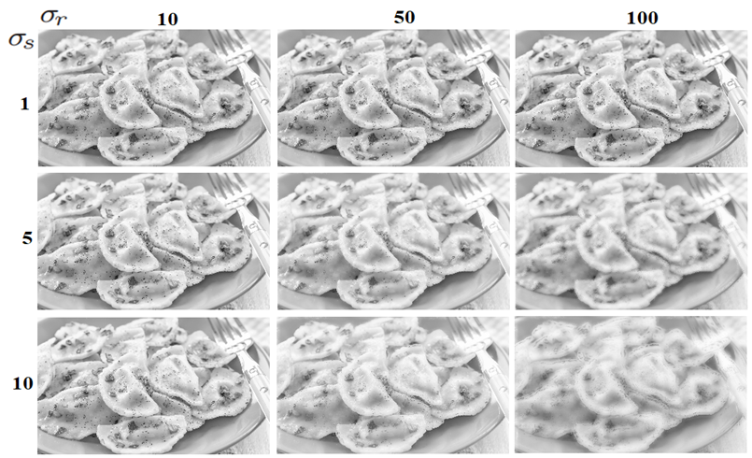
Tests for grayscale images

Slide 12
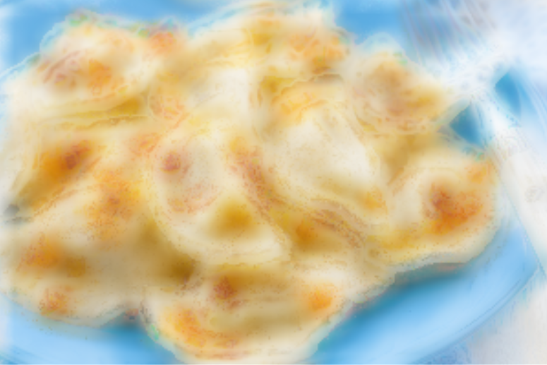
Tests for color images

Slide 13
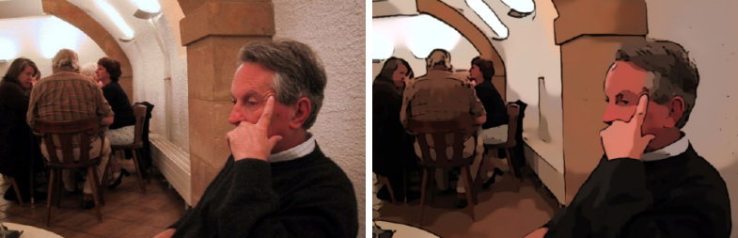
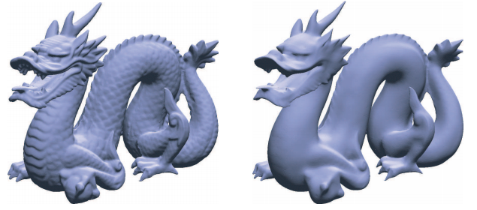
Usage of bilateral filtering

Slide 14


